Slide 1



Fraud-Shield
HackHERs
Kasak Masrani
Khushi Patel
8487921041
9714803702
kasakmasrani@gmail.com
khushin01012006@gmail.com
Drashti Chothani
Vishruti Chachadiya
6356833705
7043939107
drashtic0777@gmail.com
vishchachadiya@gmail.com

Slide 2


OBJECTIVE
PURPOSE
SCOPE
To detect and prevent fraudulent Transactions using AI based anomaly detection and user defined rules.
Provide insights into suspicious activities for better decision making.
Designed for financial institutions and businesses to inhance transactions security.

Slide 3


FUNCTIONALITIES
Transaction Management
Add, View and manage transactions.
Analyze transactions for fraud detection.
User Management
User profiles with attributes like allowed locations,transactions frequency,and average transaction amount.
Fraud Detection
AI based anomaly detection using isolation-forest.
Behavioral anomaly detection based on user patterns.
Fraud-insights with statistic
Admin dashboard with visualization.
(e.g, bar charts for fraudulent vs.
non-fraudulent transactions.).

Slide 4

Technology Used
Backend
Frontend
Numpy :
for for numerical computations.
Matplotlib:
for data visulization in admin dashboard.
Library
Integrity
Excellence
Collaboration
Django Framework:
for web application development.
MySQL:
for database management .
HTML ,CSS, Bootstrap:
for responsive and user-friendly UI.
AI/ML:
isolation forest for anomaly detection in transaction

Slide 5

RISK COVERAGE
01
Detects anomolies in transactions,amount ,frequency and locations.
01
Flags transactions from anuthorized locations.
02
identify deviations from user transation patterns.
02
Provides insights into financial regulations for flagged transactions.
03
Allow users to define specific fraud detection criteria.

Slide 6
MERITS & DEMERITS
Merits
Demerits
Inhance security:
Combines AI-based detection with user defined rules for robust fraud prevention.
Customizable:
users can define fraud rules trailored to their needs.
Scalable:
supports multiple users and transactions with efficient database management.
User Insights:
Provides detailed insights into user behaviour and transaction patterns.
Visulization:
Admin dashboard with clear and interactive visulizations.
False Positive:
AI-based detection may flag legitimate transaction as fraudulent.
Dependency on data:
Reuires accurate and sufficient data for effective anomaly detection.
Complexity:
Manageing data can be complex sometimes.
Limited Scope:
Focused on mainly financial fraud,may not cover other aspects .

Slide 7
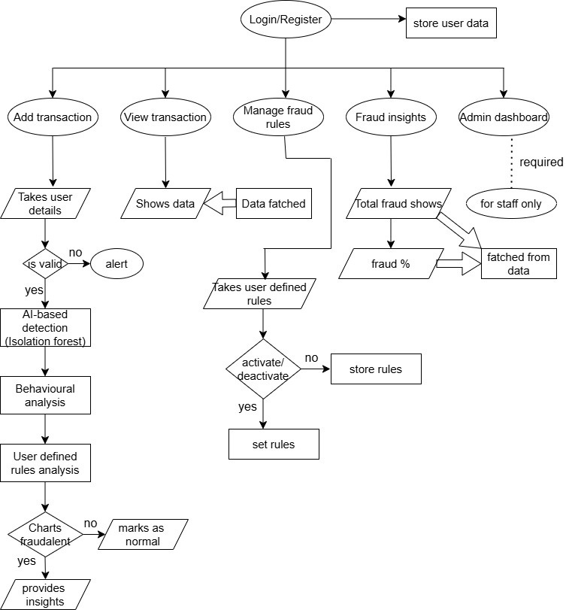
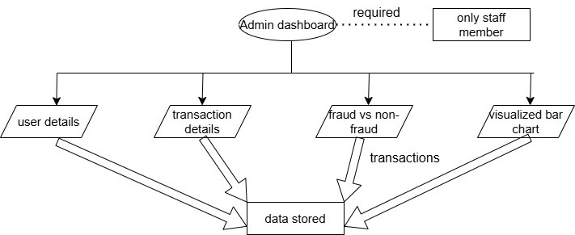
Flow Chart
THANK YOU

